Slide 1


CML: Control, Machine Learning, and Numerics
SoSe 2023
Leveraging Random Forest For Heart Disease Prediction
Prof. Dr. DhC. Enrique Zuazua
Dr. Yongcun Song
Group 14:
Alisha Mund
Anuraag Mishra
Harini Sankaran
Malavika Radhakrishnan
Shriya Mittapalli
6th July 2023 |
Notes:
Good afternoon, Professor Zuazua, Doctor Song, and fellow students. Today we are presenting on the topic, Heart Diesease Detection using Random forest. I want to start this presentation with 3 whys. Why did we choose Heart Disease . Why we think ML algorithm has a potential use case. And why did we choose Random Forest over everything else....

Slide 2

Content
Introduction
Goals & Expectations
Architecture
Mathematical Analysis
Simulation
Conclusion
Discussion
References
6th July 2023 |

Slide 3
Introduction – Why Heart Disease?
Proportion of all deaths due to major causes in Europe among men (on the left) & women (on the right) (www.who.int).
6th July 2023 |
Notes:
Heart disease is the leading cause of death globally.
WHO has estimated 12 million deaths worldwide are due to cardio vascular diseases.
In Europe it is seen that the death due to cardio vascular disease is 49% when compared to other causes.
Millions of people are at risk and early detection is crucial for effective treatment and prevention.
In this presentation, we are predicting whether the patient has 10-year risk of future coronary heart disease (CHD)

Slide 4
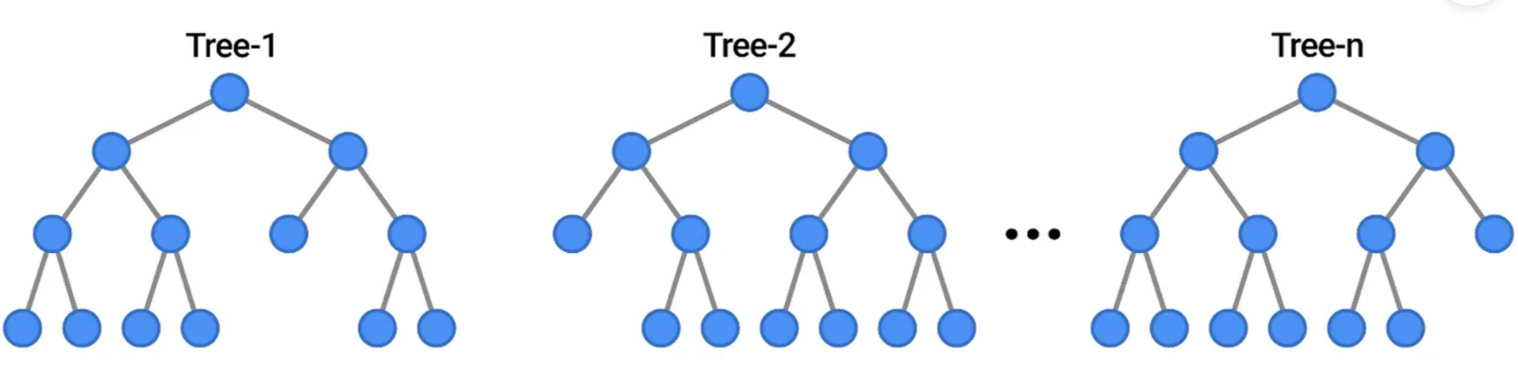
Introduction – Why Random Forest?
Robustness to Overfitting
Interpretability
Age > 50
No
Yes
BMI > 55
No
Yes
CHD risk
Random Forest with n decision trees
Partial Visualization of a Decision Tree to show Interpretability
6th July 2023 |
Notes:
Random forest is a commonly-used machine learning algorithm, which combines the output of multiple decision trees to reach a single result
Random forest – multiple decision trees to predict
Robustness to Overfitting: One key reason to choose Random Forest over some other machine learning algorithms is its robustness to overfitting. Overfitting is a common problem in machine learning where a model performs well on the training data but poorly on unseen data (like the test set or new data in production).
A single decision tree, for example, can easily overfit the training data by creating complex rules that fit the training data very well but fail to generalize to new data. Random Forests, decision trees can be trained independently, allowing for parallel processing and faster training, It mitigate this by averaging predictions from a large number of independently grown trees. This ensemble approach leads to a model that captures the underlying patterns in the data well without fitting the noise in the training data too closely, thus providing better performance on unseen data.
Interpretability: Another key reason to choose Random Forest, or indeed any tree-based method, is its interpretability. In the complex landscape of machine learning algorithms, many powerful models (like neural networks) are often referred to as "black boxes" because while they can generate very accurate predictions, it's hard to understand how they arrived at a particular decision.
Furthermore, Random Forests provide measures of feature importance which give an overview of which features are most influential in making predictions across all the trees. This kind of information can be invaluable in understanding the model and making decisions about feature engineering and selection.

Slide 5

Goals and Expectations
Input
Binary Classification
Demographic
Risk
Behavioural
Past Medical History
No Risk
Random Forest Algorithm
Current Medical History
6th July 2023 |
Notes:
We are inputting several attributes which are potential risk for CHD into the model
Using RF algo we can classify the data into having risk or no risk

Slide 6
Architecture
Training Data
Bootstrapping
Random Feature Selection
Ensemble model
Testing Data
Decision Tree 1
Decision Tree 2
Decision Tree n
Aggregation
Class Prediction
6th July 2023 |
Notes:
First, the individual decision trees can be trained independently, allowing for parallel processing and faster training. Second, the randomness in feature selection and data sampling helps to reduce overfitting and improve the generalization of the model. Finally, by combining the predictions of multiple trees, the random forest tends to produce more robust and accurate results compared to a single decision tree.
Overall, a random forest is like a team of decision-making experts that work together to solve a problem by combining their individual predictions. This teamwork and diversity in predictions make the random forest a powerful and reliable machine learning model.
, we start with a set of training data, which includes input features and their corresponding labels.
In bootstrapping we have Random subsets of the training data are called bootstrap samples and each subset selects random input features from the full set of features. This is feature randomization. It helps introduce diversity among the trees in the random forest.
Using each bootstrapped samples and random feature selection , decision trees are created.
Once all the decision trees are created they can work together to make prediction.
When a new input (test data) is given, it is passed through ensemble model with n decision trees
Each decision tree independently predicts the target label based on its own set of rules and the input features
The idea behind the random forest architecture is that by combining the predictions of multiple decision trees, the ensemble can capture more diverse patterns in the data and make more accurate predictions. The randomness introduced during training, such as bootstrap sampling and feature bagging, helps prevent overfitting and improves the generalization ability of the random forest.

Slide 7
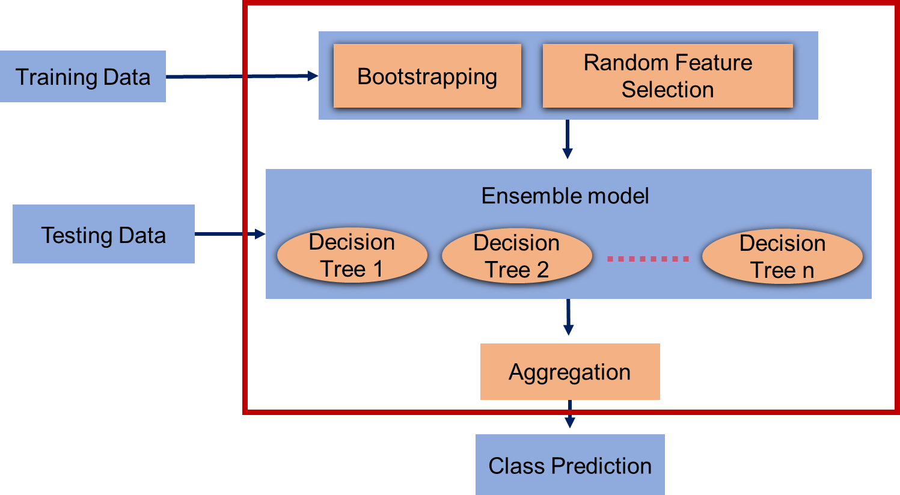
Bagging
1. Powerful method based on 2 steps
Bootstrapping
Aggregation
2. Parallel process
6th July 2023 |
Notes:
Bagging includes 2 main process.
First one is the Bootstrapping where samples are selected randomly with replacement and selecting random features for each decision tree.
The second step is the aggregation step used for final class prediction of the new data using the ensemble model which is discussed later.
Advantage with bagging is multiple decision trees are trained at the same time that is the process happens in parallel which reduces training time.

Slide 8
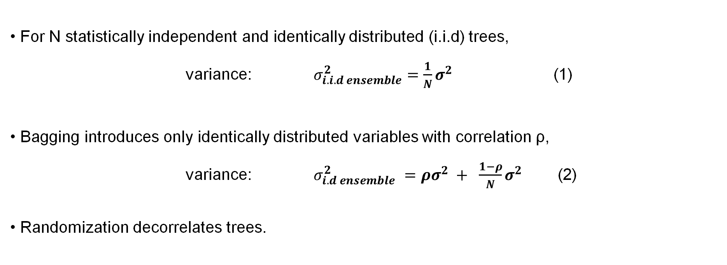
Bagging – Rationale behind Randomization
• For N statistically independent and identically distributed (i.i.d) trees,
variance: $σ_{i.i.d ensemble}^{2}=\frac{1}{N}σ^{2}$ (1)
• Bagging introduces only identically distributed variables with correlation ρ,
variance: $σ_{i.d ensemble}^{2}$ $=ρσ_{ }^{2}+ \frac{1−ρ}{N}σ^{2}$ (2)
• Randomization decorrelates trees.
6th July 2023 |
Notes:
Now lets see y we need randomization?
For n statistically independent and identically distributed trees, the variance is given by average of n i.i.d. random variables, each with variance σ2.
Since bagging selects samples with replacement independence is gone and only identically distributed variables with pairwise correlation rho is considered.
The total variance of all decision trees depends on correlation rho and no.of trees N
As no.of trees increases, the variance decrease but from the equation it is seen that the variance depends on the correlation factor so reducing correlation gives low variance so bootstrapping helps to avoid overfitting.
Generally we believe that the more the data the better model we get. But in this case suppose if data set contains one very strong predictor along with other moderate predictor then all trees would look similar as they consider the same predictor in the top which can be avoided by random selecting features which decorrelates trees. What do you mean by decorrelate?

Slide 9
Bagging – Bootstrapping & Random Feature Selection
ID | Male | Age | Current Smoker | Diabetes | totChol | sysBP | diaBP | HeartRate | Glucose | CHD
0 | 1 | 39 | 0 | 0 | 195 | 106 | 70 | 80 | 77 | 0
1 | 0 | 55 | 1 | 0 | 250 | 121 | 81 | 95 | 76 | 0
2 | 1 | 48 | 1 | 0 | 245 | 127.5 | 80 | 75 | 70 | 0
3 | 0 | 61 | 1 | 0 | 225 | 150 | 95 | 65 | 103 | 1
4 | 0 | 46 | 1 | 0 | 285 | 130 | 84 | 85 | 85 | 0
Dataset:
Bootstrapped Samples:
ID: 0, 4, 3, 0, 4
ID: 3, 2, 3, 2, 3
ID: 2, 3, 2, 0, 3
Out of Bag Samples:
ID: 1, 2
ID: 0, 1, 4
ID: 1, 4
Feature selection:
Male(M) , diaBP(B)
Glucose(G), totChol(T)
CurrentSmoker(S), age(A)
M
G
S
Yes
No
< 100
>= 100
No
Yes
0
B
0
1
0
A
>= 85
< 85
< 50
>= 50
1
0
0
1
6th July 2023 |
Notes:
Bagging enables cross-validation without a separate validation set: Use Out-of-bag samples, i.e., samples not part of the bag of each tree, for validation.
Based on the splitting criteria of the selected features and bootstrapped samples decisions are constructed. Splitting criteria will be discussed later.

Slide 10
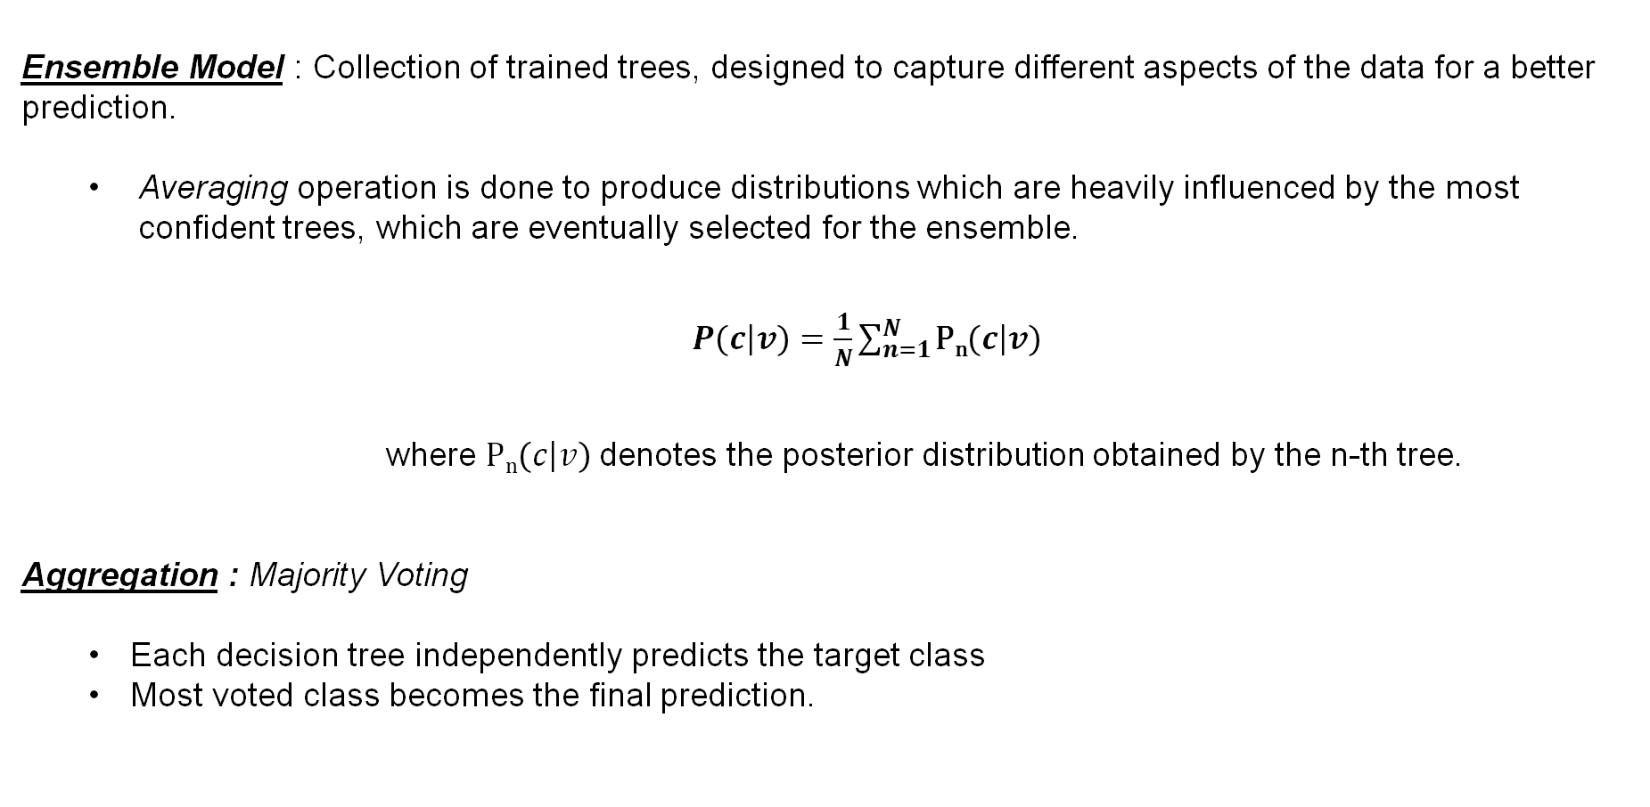
Bagging – Aggregation
Ensemble Model : Collection of trained trees, designed to capture different aspects of the data for a better prediction.
Averaging operation is done to produce distributions which are heavily influenced by the most confident trees, which are eventually selected for the ensemble.
$P\left(\left.c\right|v\right)=\frac{1}{N}\sum_{n=1}^{N}{\text{P}\text{n}\left(\left.c\right|v\right)}$
where P_{n}$\left(\left.c\right|v\right)$denotes the posterior distribution obtained by the n-th tree.
Aggregation : Majority Voting
Each decision tree independently predicts the target class
Most voted class becomes the final prediction.
6th July 2023 |

Slide 11
Bagging – Aggregation
Test Data
ID | M | A | S | Diabetes | T | sysBP | B | HeartRate | G | CHD
1 | 0 | 55 | 1 | 0 | 250 | 121 | 81 | 95 | 76 | 0
Classifier 1
Classifier 2
Classifier 3
Classifier 4
Classifier 5
M
G
S
B
T
No
Yes
< 100
>= 100
No
Yes
<85
>=85
> 150
<= 150
0
B
0
1
1
A
0
S
1
0
>= 85
< 85
< 50
>= 50
Yes
No
1
0
0
1
1
0
Prediction: 0
No Risk
Prediction: 0
No Risk
Prediction: 1
Risk
Prediction: 0
No Risk
Prediction: 1
Risk
Final Prediction : No Risk
6th July 2023 |
Notes:
Shriya till here

Slide 12
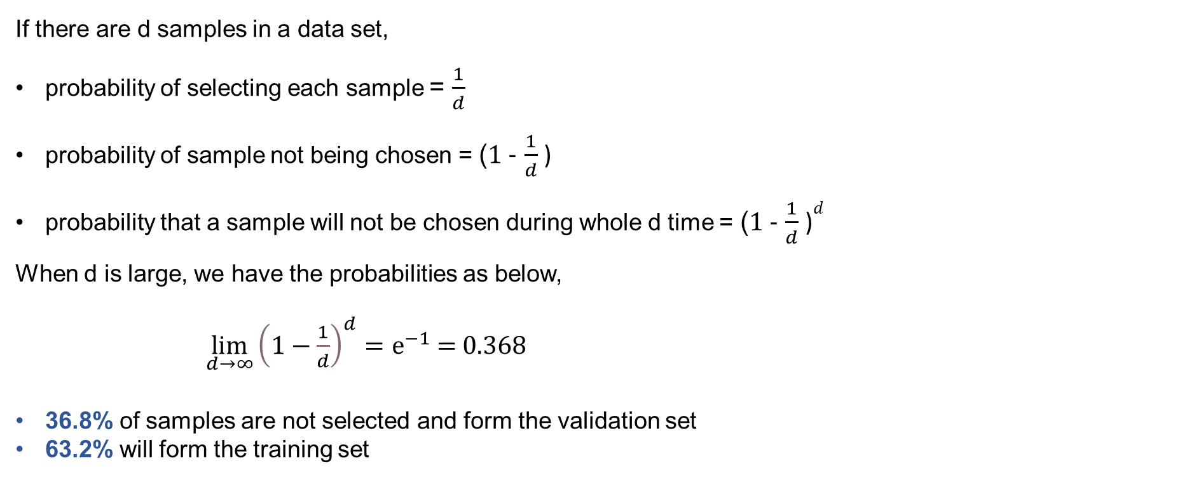
Bagging – Out of Bag Samples
If there are d samples in a data set,
probability of selecting each sample = $\frac{1}{d}$
probability of sample not being chosen = (1 - $\frac{1}{d}$ )
probability that a sample will not be chosen during whole d time = (1 - $\frac{1}{d}$ )$d^{}$
When d is large, we have the probabilities as below,
$\lim_{d→∞}{\left(1−\frac{1}{d}\right)}^{d}=ⅇ^{−1}$ = 0.368
36.8% of samples are not selected and form the validation set
63.2% will form the training set
6th July 2023 |
Notes:
Have to select d times.
the probability approaches e ⁻¹ = 0.368

Slide 13

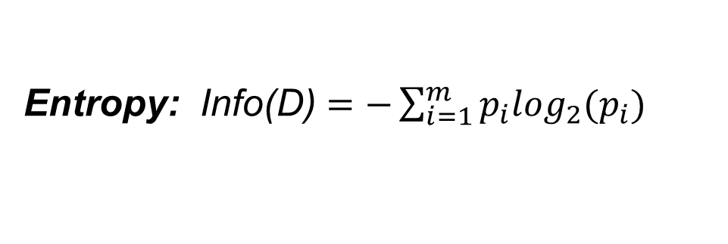
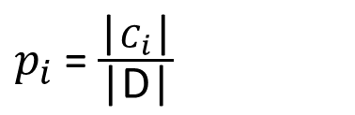
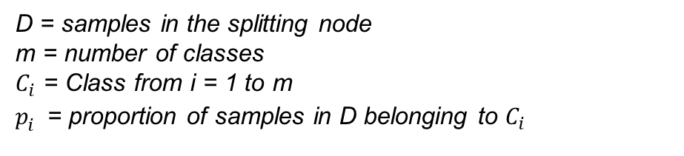
Splitting Criteria – Entropy
D = samples in the splitting node
m = number of classes
$C_{i}$ = Class from i = 1 to m
$p_{i}^{}$= proportion of samples in D belonging to $C_{i}$
Entropy: Info(D) $=−\sum_{i=1}^{m}{p_{i}\log_{2}(p_{i})}$
$p_{i}$ = $\frac{\text{|}C_{i}\text{|}}{\text{|}\text{D}\text{|}}$
Measures the disorder of the feature with the target
Ranges from 0 to 1 (usually), 0 being the optimum
Info(D) = 0
Info(D) = 1
Notes:
The question of how we split the decision trees in a random forest is answered using the criterias – entropy, gini index and information gain.
The goal is to split the dataset into different sub groups which are relatively more homogenous from the perspective of the classes. Here, the classes are 1 and 0, 1 being having risk of HD and 0 being having no risk of HD. The goal is to make the data more ‘pure’ so as to either more of 1’s or 0’s.
Entropy
Entropy is the measurement of impurities or randomness in the data points.
It is calculated using the formula - ….. , where pj = … and n = number of classes (here 2) – Shannon’s entropy
Log base 2 - measure information in bits – from information theory
Synthesised example right hand side
It is computed between 0 and 1, however, heavily relying on the number of groups or classes present in the data set it can be more than 1
Here, we will compute entropy as an example. – high entropy – high impurity
0 is optimum entropy – 1 is impure/random 50/50

Slide 14
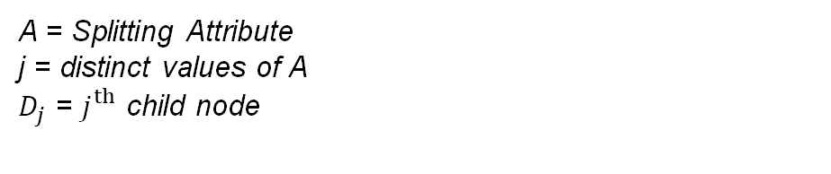
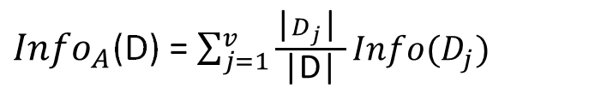
Splitting Criteria – Information gain
Information Gain: Gain(A) = Info(D) – ${Info}_{A}$(D)
A = Splitting Attribute
j = distinct values of A
$D_{j}$ = $j_{}^{th}$ child node
${Info}_{A}$(D) = $\sum_{j=1}^{v}{{\frac{\text{|}D_{j}\text{| }}{\text{|}\text{D}\text{|}}Info(D_{j})}_{}}$
It is the difference between apriori Shannon entropy Info(D) and the conditional entropy ${Info}_{A}$(D)
Helps to determine the order of attributes in the nodes
Choose attribute with highest information gain
6th July 2023 |
Notes:
Entropy is used to calculate information gain
Information gained if we take a specific feature to split on
Compare this information gain with other features’ ig
Highest information gain is taken as the feature for splitting
Should I talk about information gain ratio?

Slide 15
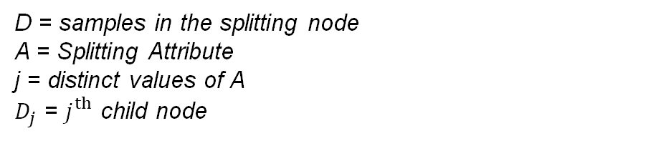
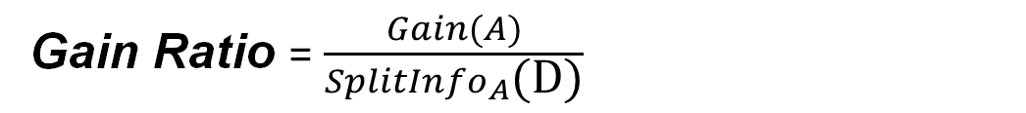
Splitting Criteria – Gain Ratio
Gain Ratio = $\frac{Gain(A)}{{SplitInfo}_{A}\text{(}\text{D}\text{)}}$
D = samples in the splitting node
A = Splitting Attribute
j = distinct values of A
$D_{j}$ = $j_{}^{th}$ child node
${SplitInfo}_{A}$(D) = - $\sum_{j=1}^{v}{{\frac{\text{|}D_{j}\text{| }}{\text{|}\text{D}\text{|}}\log_{2}\left(\frac{\text{|}D_{j}\text{| }}{\text{|}\text{D}\text{|}}\right) }_{}}$
Normalization to information gain using a “split information”
Removes bias toward tests with many outcomes
Maximum gain ratio is selected as the splitting attribute
6th July 2023 |
Notes:
Information gain tends to favor attributes with a large number of unique values or attributes with many possible splits because they can potentially lead to smaller subsets with low impurity.
This could result in decision trees that are deeper and more complex, leading to overfitting or less generalization to unseen data.
To address this bias, Gain ratio modifies the information gain metric by taking into account - number of distinct values and its distribution among the classes.
It does this by dividing the information gain by a split information term that penalizes attributes with a high number of unique values.

Slide 16
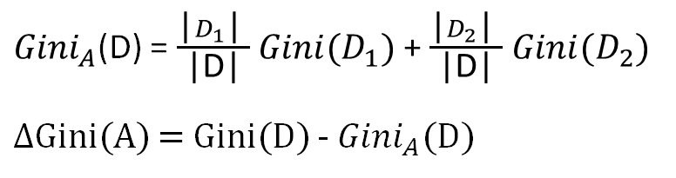
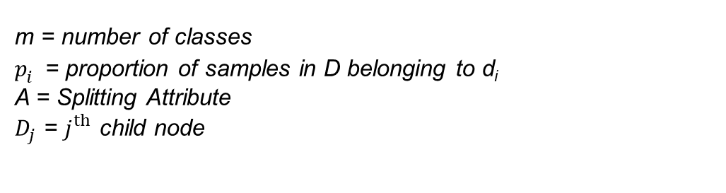
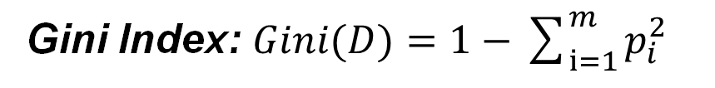
Splitting Criteria – Gini Index
Gini Index: $Gini(D)=1−\sum_{i=1}^{m}{p_{i}^{2}}$
m = number of classes
$p_{i}^{}$= proportion of samples in D belonging to d_{i}
A = Splitting Attribute
$D_{j}$ = $j_{}^{th}$ child node
${Gini}_{A}$(D) = $\frac{\text{|}D_{1}\text{| }}{\text{|}\text{D}\text{|}}$ ${Gini(D}_{1})$ + $\frac{\text{|}D_{2}\text{| }}{\text{|}\text{D}\text{|}}$ ${Gini(D}_{2})$
$Δ$Gini(A) = Gini(D) - ${Gini}_{A}$(D)
Considers a binary split for each attribute
Measures the frequency at which any element of the dataset
will be mislabelled when it is randomly labelled
Ranges from 0 to 0.5, 0 being the optimum value
Gini(D)= 0
Gini(D)= 0.5
6th July 2023 |
Notes:
Like entropy – gini index also measures the impurity of the dataset
Specifically, it measures the frequency at which any element of the dataset will be mislabelled when it is randomly labeled.
Entropy v/s gini - what did we use in our data set
When considering a binary split, we compute a weighted sum of the impurity of each
resulting partition. For example, if a binary split on A partitions D into D1 and D2, the
Gini index of D given that partitioning is

Slide 17
Hyperparameter Tuning
1. Max depth - longest path between the root node and the leaf node
2. N estimators - number of decision trees
Depth = 2
N estimators = 5
6th July 2023 |
Notes:
A tree is incomplete without a split or child node. max_depth determines the maximum number of splits each tree can take. If the max_depth is too low, the model will be trained less and have a high bias, leading the model to underfit. In the same way, if the max_depth is high, the model learns too much and leads to high variance, leading the model to overfit
As mentioned before in the rationale behind randomization, the more strees we have the random forest performs better. However, having more trees also increases the complexity of the algorithm.

Slide 18
Hyperparameter Tuning
3. Max leaf nodes - condition on the splitting of the nodes restricts the growth of the tree.
4. Min sample leaf - minimum number of samples that should be present in the leaf node after splitting a node
Max leaf nodes = 3
Min sample leaf = 3
6th July 2023 |
Notes:
Maximum leaf nodes – We can also restrict the number of leaf nodes any decision tree can have in the random forest – the more the leaf nodes – more the data is overfit
Minimum sample leaf -

Slide 19
Generalization Error
If h1(x), h2(x), . . . . hk(x) is an ensemble of classifiers with the training set {X, Y}, the margin function is:
$$mg\left(x,y\right)=av_{k}I\left(h_{k}\left(x\right)=y\right)−\max{j}≠Y av_{k}I\left(h_{k}\left(x\right)=j\right)$$
and the generalisation error is given by:
PE* = P_{X,Y} (mg(X,Y) < 0)
Our goal is to reduce the generalization error and have a high margin as it indicates a higher confidence in correct classification.
6th July 2023 |
Notes:
The margin measures the difference between the average number of votes for the correct class and the maximum average number of votes for any other class.
The term avk I(hk(X) = Y) represents the average number of votes from all the classifiers in the ensemble that correctly predict the class Y for a given input X.
The term maxj ≠ Y avk I(hk(X) = j) represents the maximum average number of votes from all the classifiers in the ensemble for any class j other than the correct class Y.
A larger margin indicates higher confidence in the classification
PE quantifies the probability of encountering a negative margin for a randomly drawn input X and its true label Y.
As the number of trees in the random forest increases, the generalization error converges to the probability of having a negative margin. In other words, as the ensemble size grows, the probability of making an incorrect prediction decreases, resulting in improved classification performance and more confidence in the predictions made by the random forest model.
This result explains why random forests do not overfit as more trees are added, but produce a limiting value of the generalization error.

Slide 20
Simulation – Model Training
Data Collection
Data Preprocessing
Model Training
Evaluation
Workflow Visualization for Random-Forest-Classifier model training.
6th July 2023 |

Slide 21
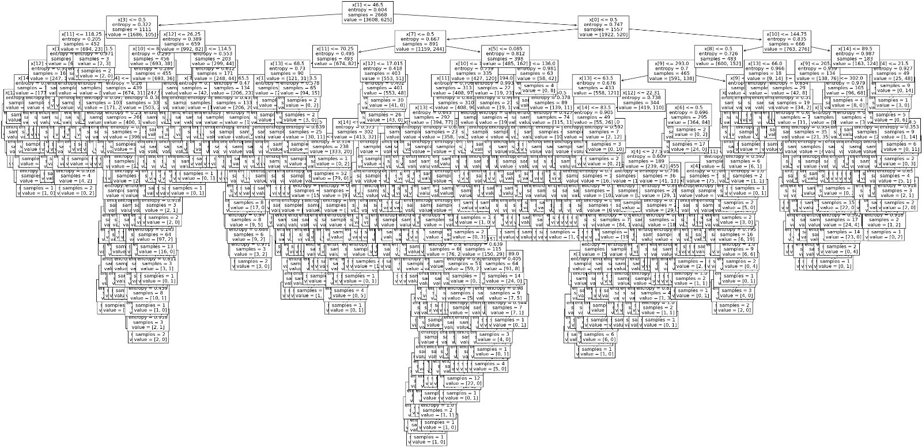
Simulation – Decision Tree
Jupyter Notebook, scikit-learn Library
6th July 2023 |

Slide 22
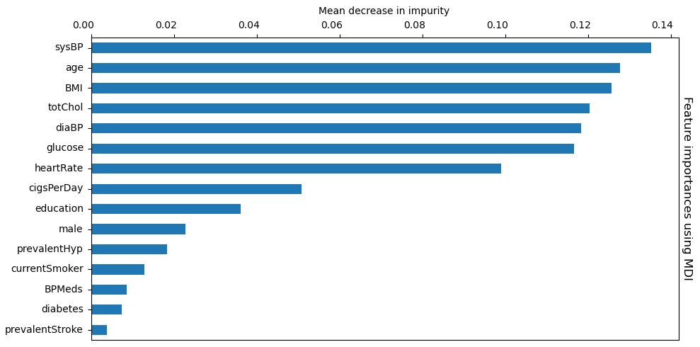
Simulation – Feature Importance
(MDI)
Jupyter Notebook, scikit-learn Library
6th July 2023 |

Slide 23
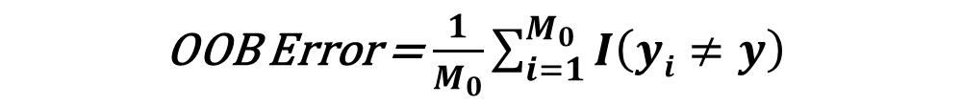
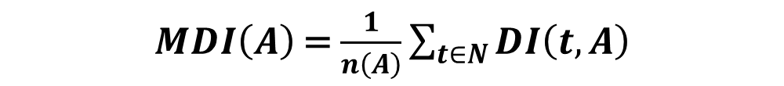
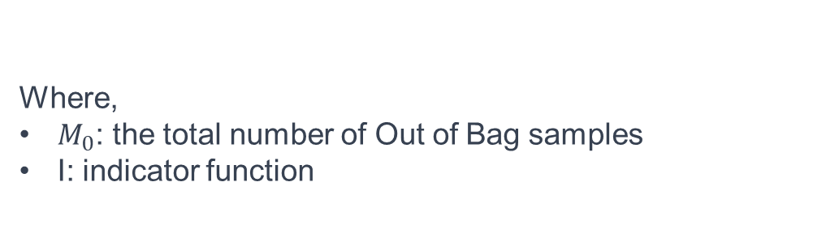
Simulation – MDI
$MDI\left(A\right)$= $\frac{1}{n\left(A\right)}\sum_{t∈N}{DI\left(t,A\right)}$
Where,
MDI(A): Mean Decrease Impurity for feature A.
t: Individual tree in the set of all trees N.
DI(t, A): The decrease in impurity in tree t due to feature A.
n(A): Total number of nodes where A splits.
For each decision tree, Accuracy/Out-of-bag Error is given by,
Where,
$M_{0}$: the total number of Out of Bag samples
I: indicator function
OOB Error = $\frac{1}{M_{0}}\sum_{i=1}^{M_{0}}{I\left(yi≠y\right)}$
6th July 2023 |
Notes:
The decrease in impurity can be calculated using the Gini impurity index, which for a binary classification problem, can be calculated as:
Gini(t) = 1 - p² - (1-p)²
where p is the proportion of samples in node t that belongs to the positive class.
So the decrease in impurity for a split at node t, using feature X, is given by:
DI(t, X) = Gini(t) - p_left * Gini(t_left) - p_right * Gini(t_right)
where t_left and t_right are the left and right child nodes of t respectively, and p_left and p_right are the proportions of samples that reach those nodes.
Then, for each feature, we sum the decrease in impurity over all nodes where that feature is used for splitting, and over all trees in the forest:
MDI(X) = sum_{all t in all trees, where feature X splits t} [DI(t, X)]
Finally, to make it an average (mean), we divide by the total number of nodes where feature X is used for splitting across all trees:
Mean Decrease Impurity (MDI) or Gini Importance of feature X = MDI(X) / total number of nodes where X splits
This gives us a measure of how important feature X is, on average, in the ensemble of trees that make up the Random Forest. A higher MDI indicates a more important feature.

Slide 24
Simulation – Confusion Matrix
True Label
1060 | 7
200 | 5
1000
TP
FP
Accuracy = (TP + TN) / (P + N) = 83.3%
No Heart Disease
800
Precision = TP / (TP + FP) = 99.3%
600
Recall = TP / (TP + FN) = 84.1%
400
Heart Disease
F1 = 2 * ( Precision * Recall ) = 91.3%
( Precision + Recall )
FN
200
TN
No Heart Disease
Heart Disease
Predicted Label
6th July 2023 |

Slide 25
Conclusion
Accuracy, Robustness & Interpretability.
Early and accurate detection of heart disease can lead to timely interventions, improved patient outcomes, and reduced healthcare costs.
In regard to our simulation, the features didn't have high mean decrease impurity and imbalanced dataset, which didn't help in good classification.
6th July 2023 |
Notes:
To conclude…
Offers significant advantages in accuracy, robustness, and interpretability.
Due to Bootstrapping, we consider all combinations of features and data samples which helps to make more reliable and accurate predictions.
Early and accurate detection of heart disease can lead to timely interventions, improved patient outcomes, and reduced healthcare costs.

Slide 26
Discussion
Some Disadvantages:
Memory-intensive
Sensitive to noise
The future of heart disease prediction using Random Forest holds promising developments. Here are some future predictions:
Hybrid Models Ensemble: Leveraging other ML models with RF to improve CHD risk detection.
Features selection importance: Train RF after removing all correlated features as well as the remove features with low feature importance. This may improve Generalization at the cost of higher variance.
6th July 2023 |
Notes:
The future of heart disease prediction using Random Forest holds promising developments. Here are some future predictions:
Ensemble of Hybrid Models: Combining Random Forest with other advanced machine learning techniques, such as deep learning or hybrid models, to further enhance heart disease prediction accuracy. This ensemble approach could leverage the strengths of different algorithms, leading to even better performance.
Random Forest with Feature Selection: Feature selection techniques can be incorporated into the Random Forest algorithm to identify the most informative features for heart disease prediction. Methods like Recursive Feature Elimination (RFE) or feature importance ranking can be applied to select a subset of relevant features before constructing the Random Forest model. This approach can improve the model's efficiency and interpretability. (important feature neglected)

Slide 27
References
Lecture Pattern Analysis Part 04: Random Forests and their Variants by Prof. Christian Riess
Townsend, N., Nichols, M. S., Scarborough, P., & Rayner, M. (2015, October). Proportion of all deaths due to major causes in Europe, latest.
Criminisi, A., Shotton, J., & Konukoglu, E. (2011). Decision Forests: A Unified Framework for Classification, Regression, Density Estimation, Manifold Learning and Semi-Supervised Learning.
Breiman, L. (2011, January). Random Forests. Statistics Department, University of California, Berkeley, CA 94720.
Death Causes : www.who.int
Dataset: www.kaggle.com
Data Mining Concepts and Techniques – Jiawei Han, Micheline Kamber, Jian Pei
6th July 2023 |
Notes:
The future of heart disease prediction using Random Forest holds promising developments. Here are some future predictions:
Ensemble of Hybrid Models: Combining Random Forest with other advanced machine learning techniques, such as deep learning or hybrid models, to further enhance heart disease prediction accuracy. This ensemble approach could leverage the strengths of different algorithms, leading to even better performance.
Random Forest with Feature Selection: Feature selection techniques can be incorporated into the Random Forest algorithm to identify the most informative features for heart disease prediction. Methods like Recursive Feature Elimination (RFE) or feature importance ranking can be applied to select a subset of relevant features before constructing the Random Forest model. This approach can improve the model's efficiency and interpretability. (important feature neglected)

Slide 28
Thank you!
6th July 2023 |
Notes:
Good afternoon, Professor Zuazua, Doctor Song, and fellow students. Today we are presenting on the topic, Heart Diesease Detection using Random forest. I want to start this presentation with 3 whys. Why did we choose Heart Disease . Why we think ML algorithm has a potential use case. And why did we choose Random Forest over everything else....

